Slide 1

CSIT940 Research Methodology
Tutorial Class
Location: N512
Time: UOW WEEK 1-13
THU 16:05 – 18:05

Slide 2
Outline
What is LATEX?
What can LATEX be used for?
How does LATEX work?
How to use LATEX?

Slide 3
What is LATEX?
Notes:
模板来自于 http://docer.wps.cn

Slide 4
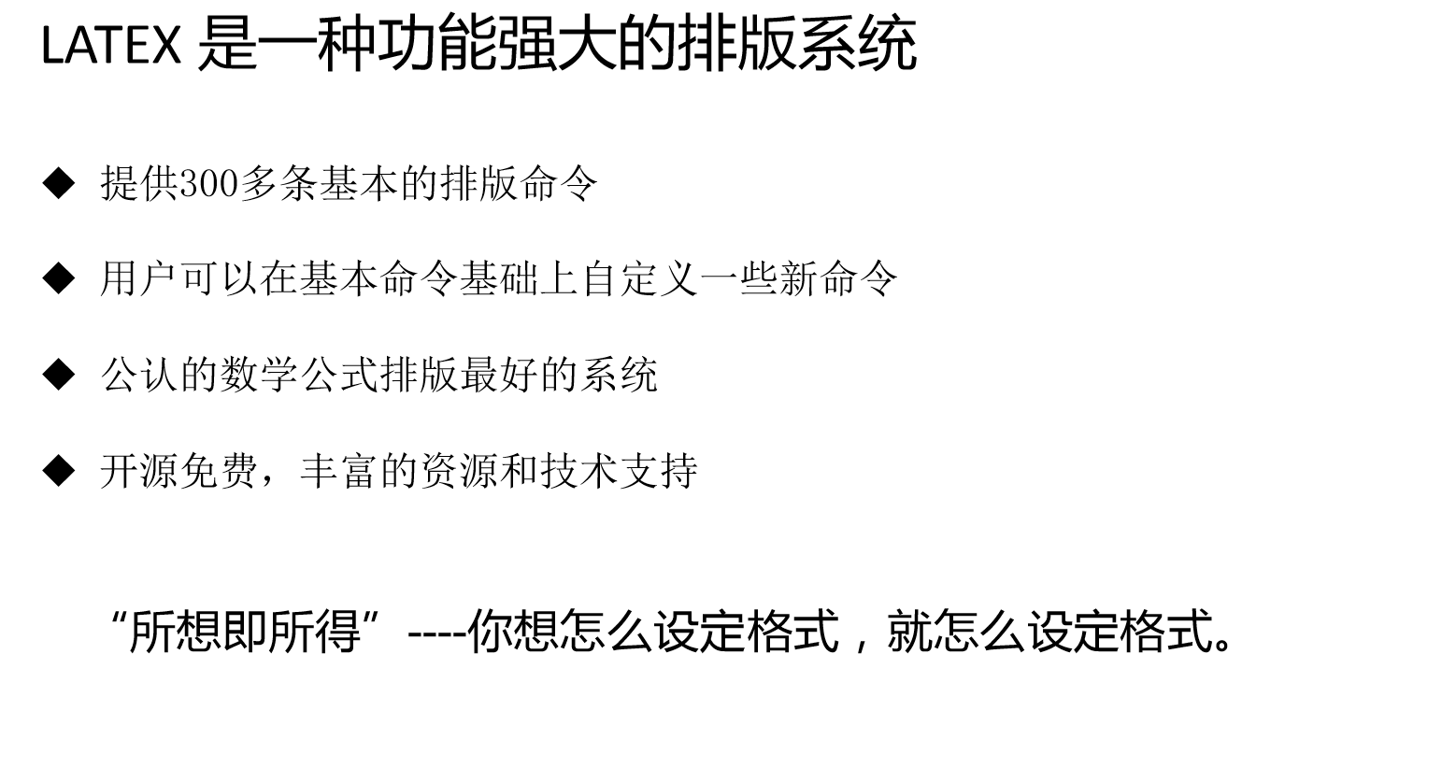

Slide 5


Slide 6
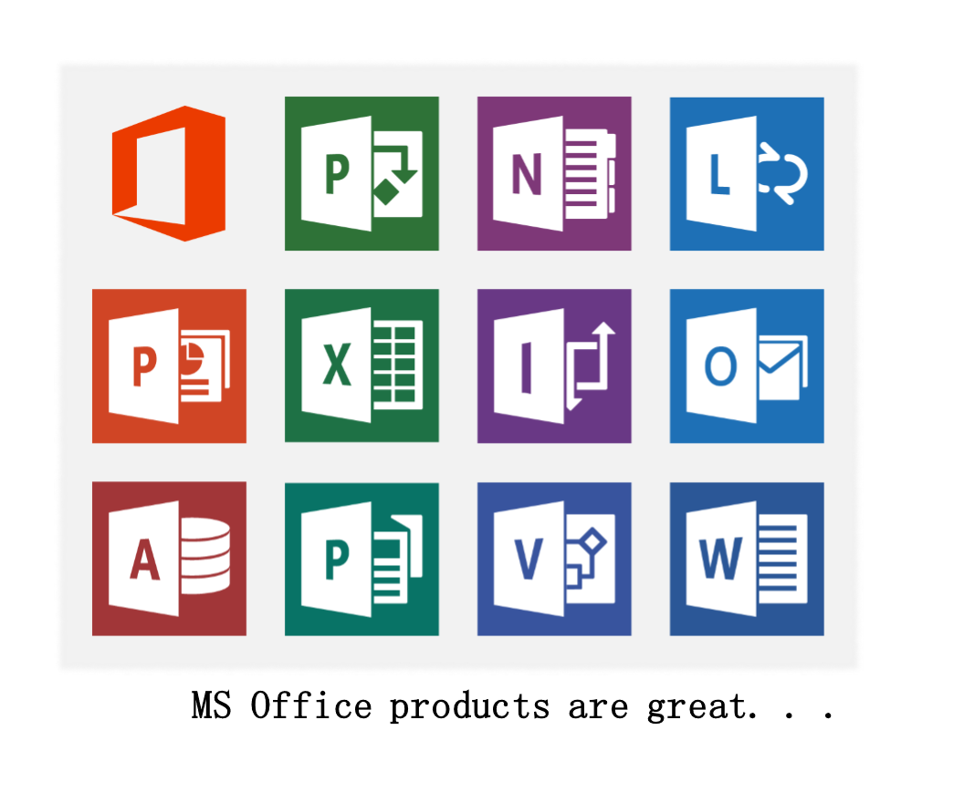


Slide 7


Slide 8
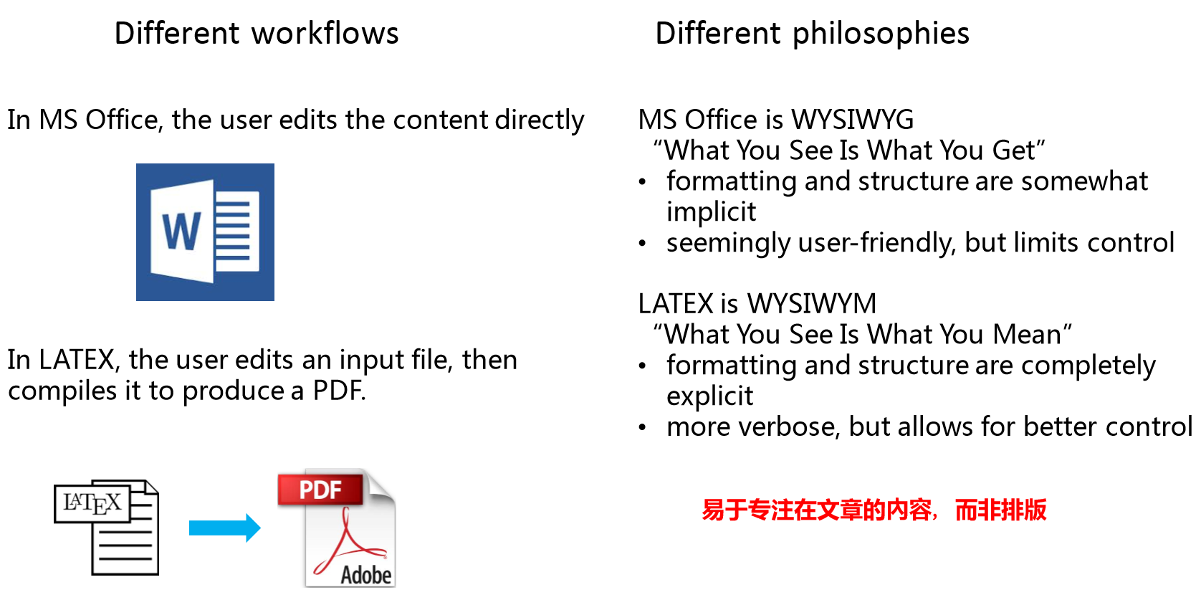
Why use LETEX?

Slide 9
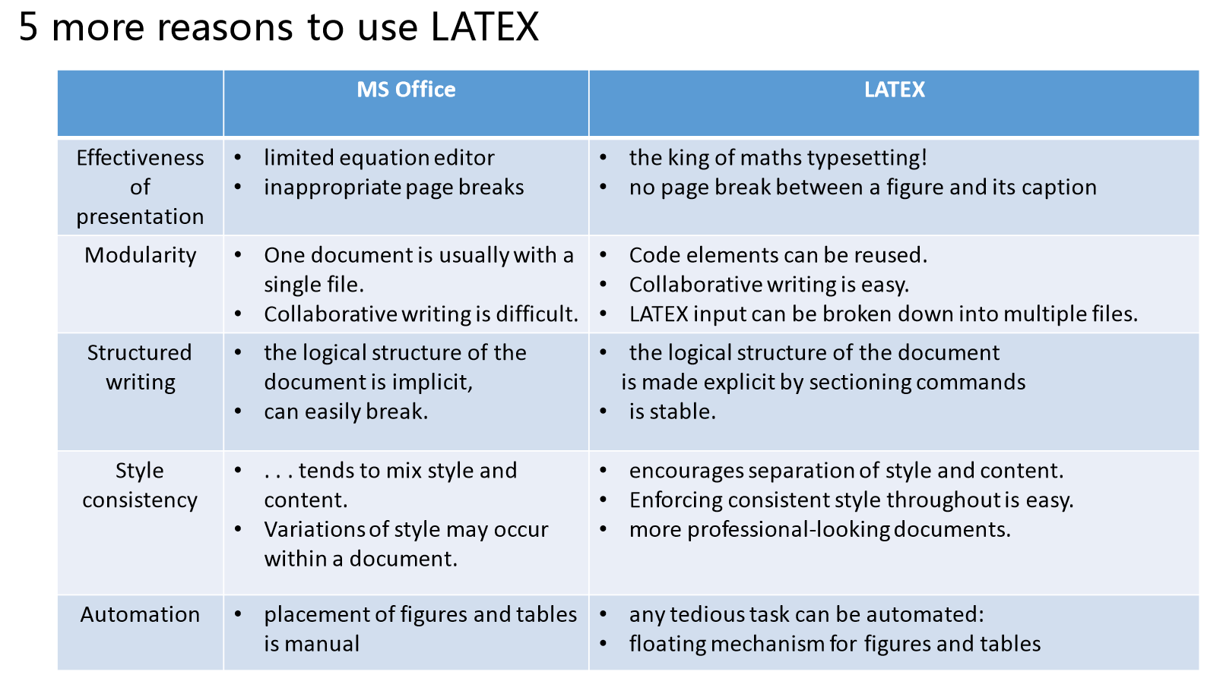

Slide 10
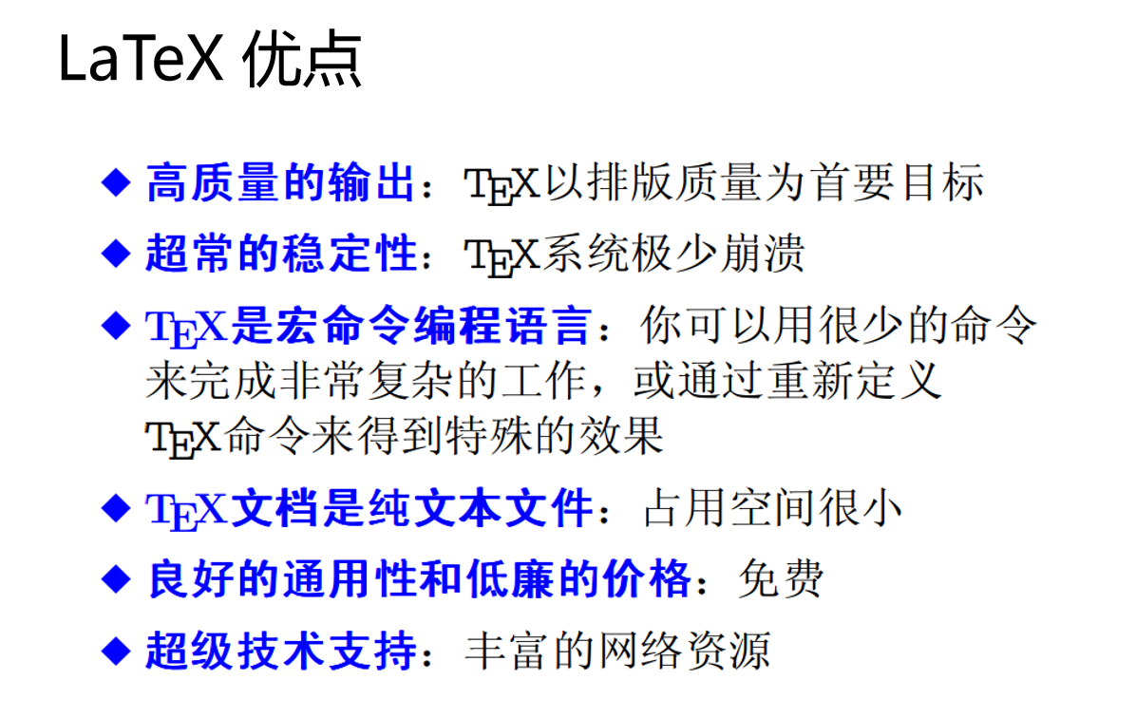

Slide 11
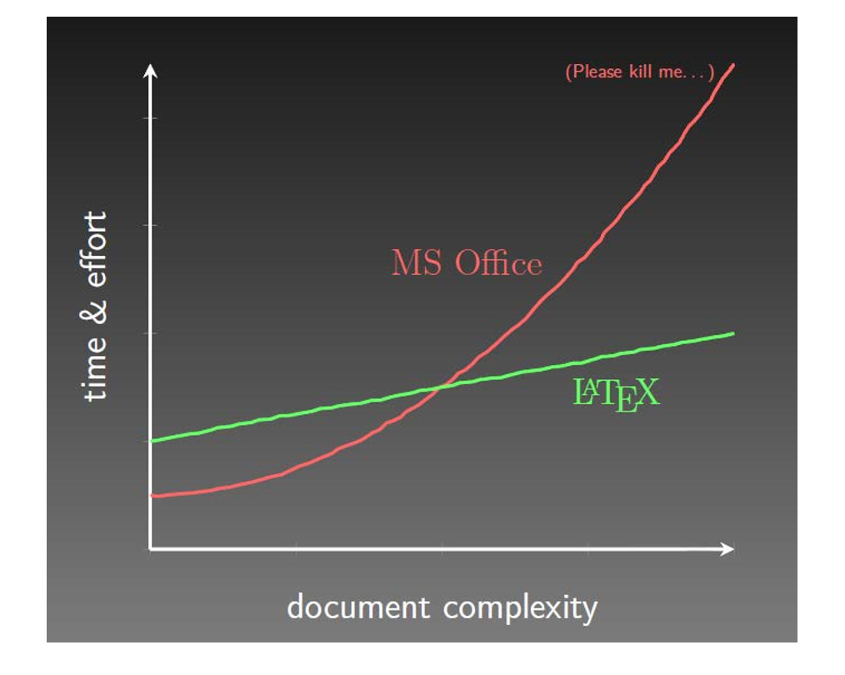

Slide 12
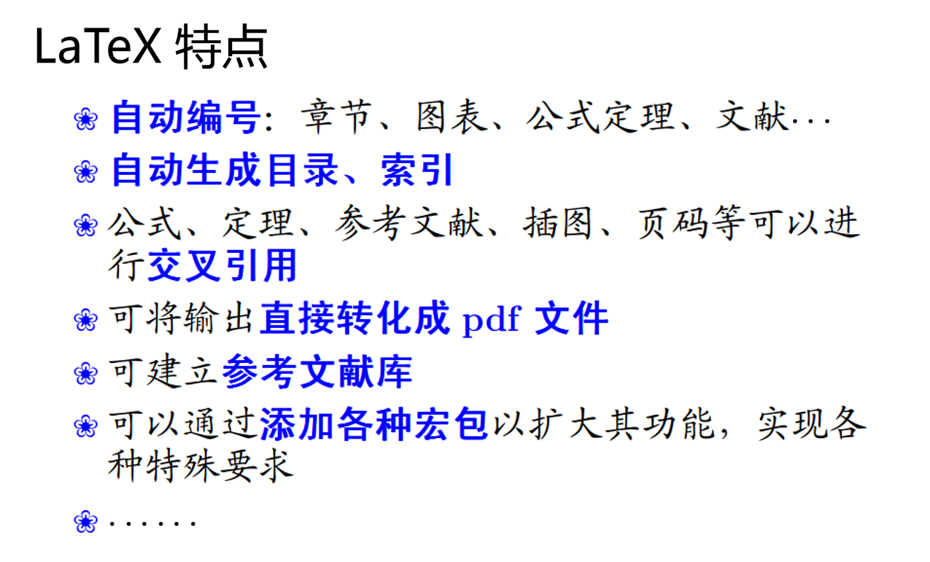

Slide 13
What can LATEX be used for?
Notes:
模板来自于 http://docer.wps.cn

Slide 14
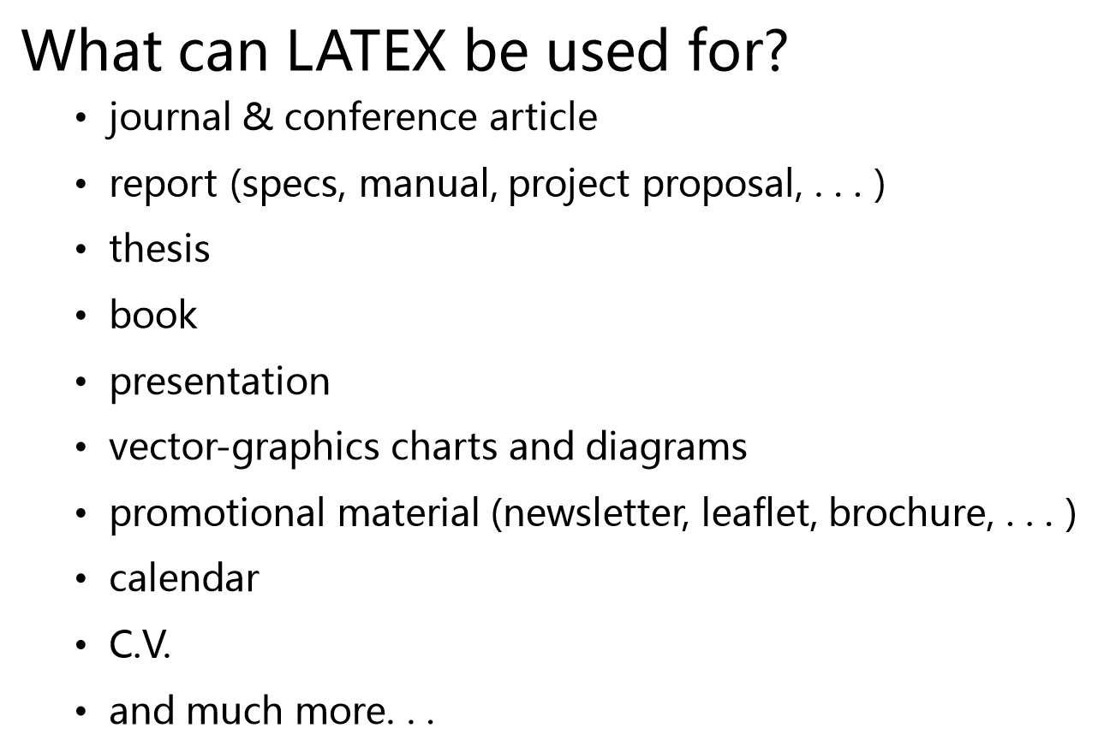

Slide 15
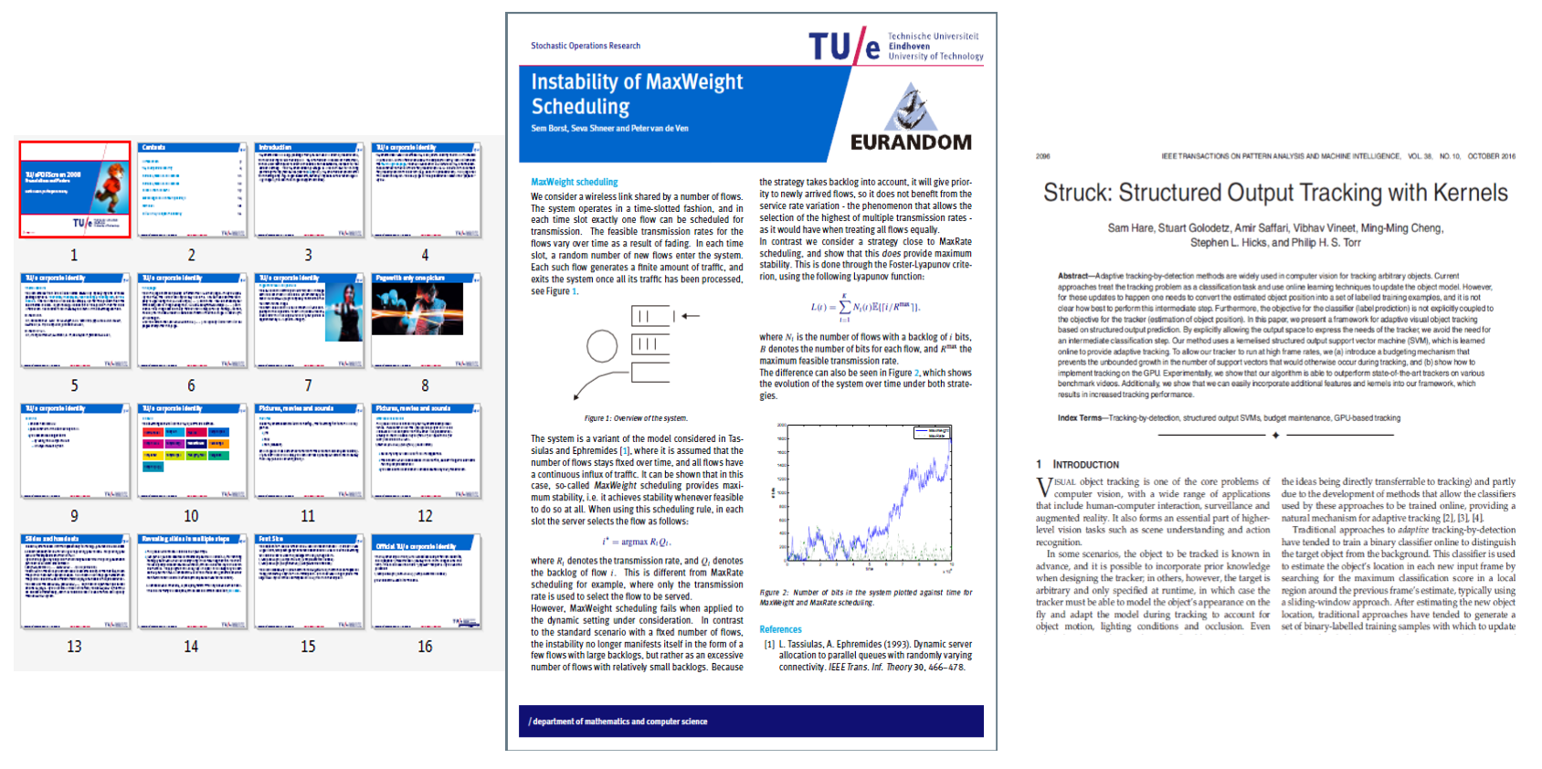

Slide 16
How does LATEX works?
Notes:
模板来自于 http://docer.wps.cn

Slide 17
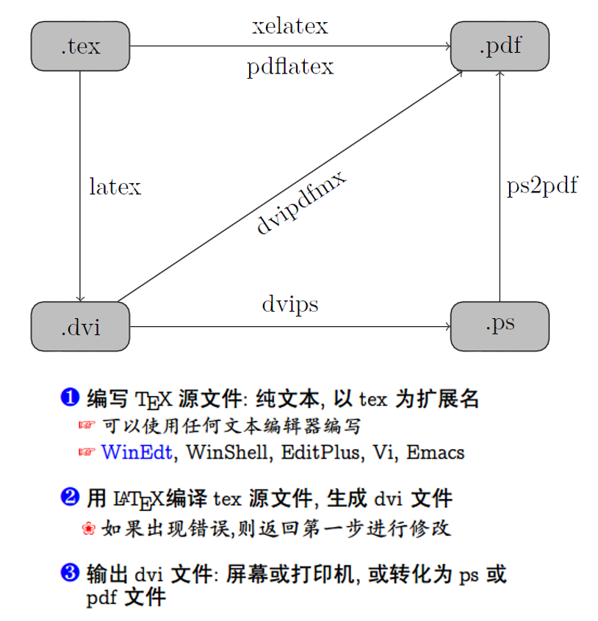

Slide 18
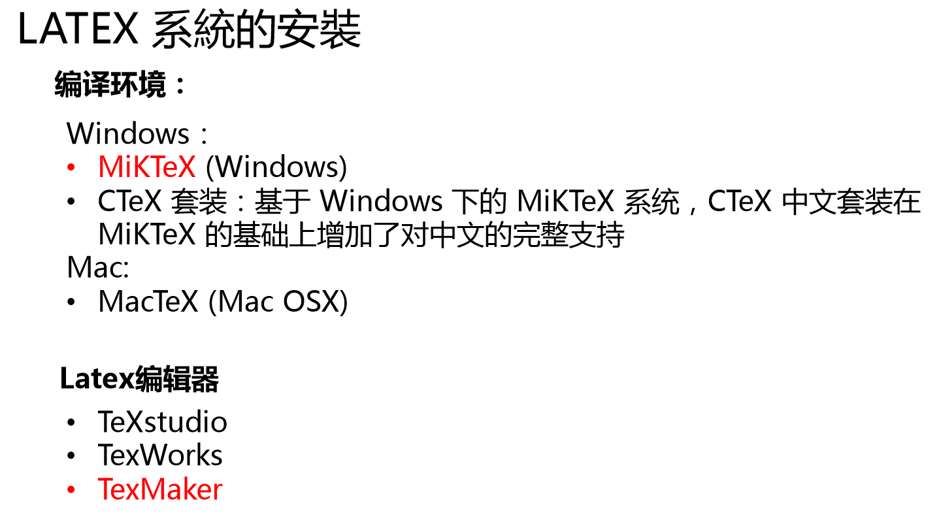
http://miktex.org/

Slide 19

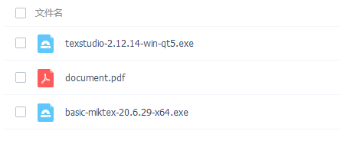
链接：https://pan.baidu.com/s/1yrcA7BCxR5bsvpfQqTN0Nw
提取码：CSRM

Slide 20
Offline:
https://www.jianshu.com/p/37a3c22cc746
为Sublime Text 3 配置LaTex (Windows)
https://www.jianshu.com/p/50a813c8a6ea
macOS + Sublime Text + Latex 环境配置(MacOS)
Online:
Overleaf
https://www.overleaf.com/
template （http://www.latextemplates.com/）

Slide 21
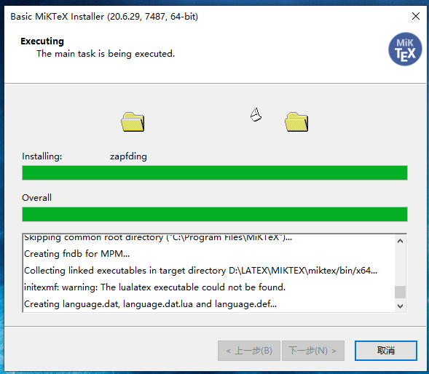
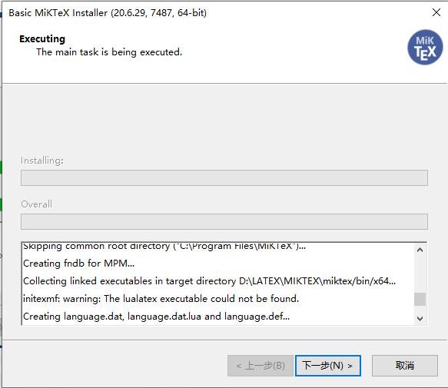

Slide 22
How to use LATEX?
Notes:
模板来自于 http://docer.wps.cn

Slide 23
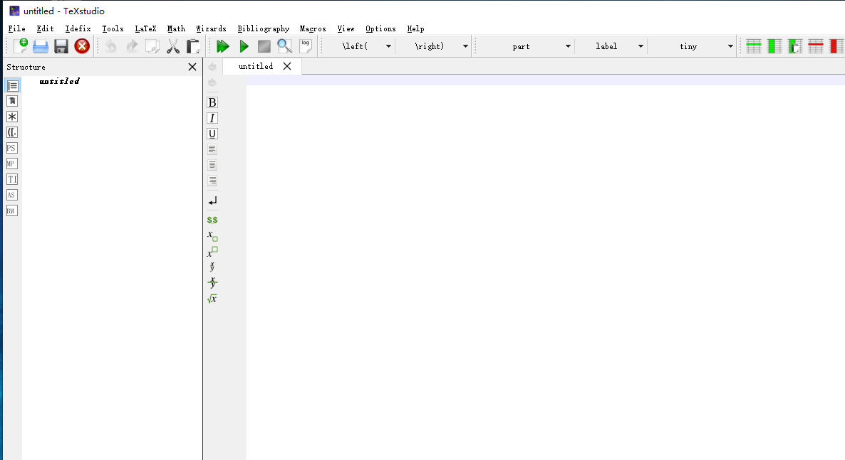

Slide 24
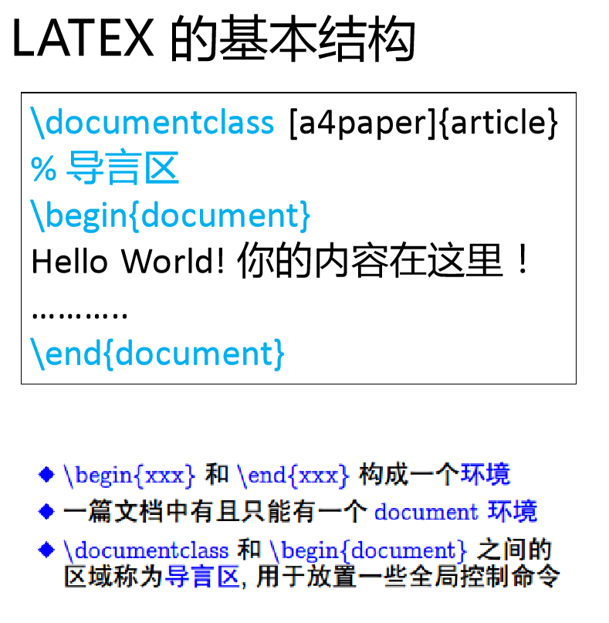

Slide 25
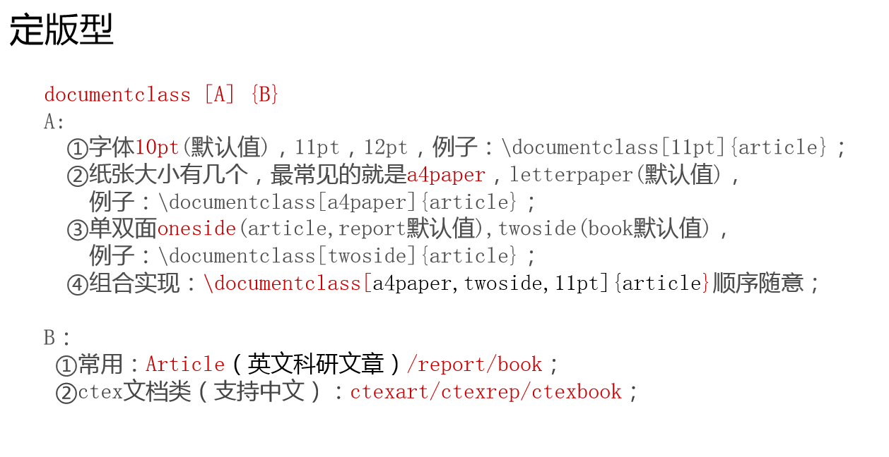

Slide 26
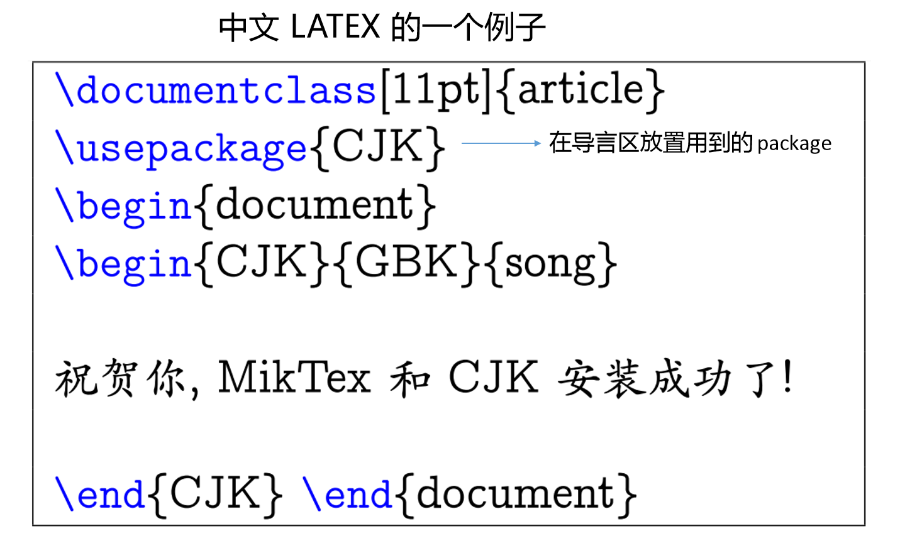

Slide 27
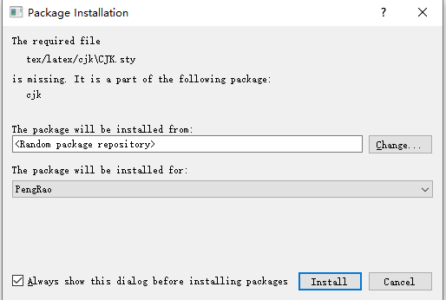

Slide 28
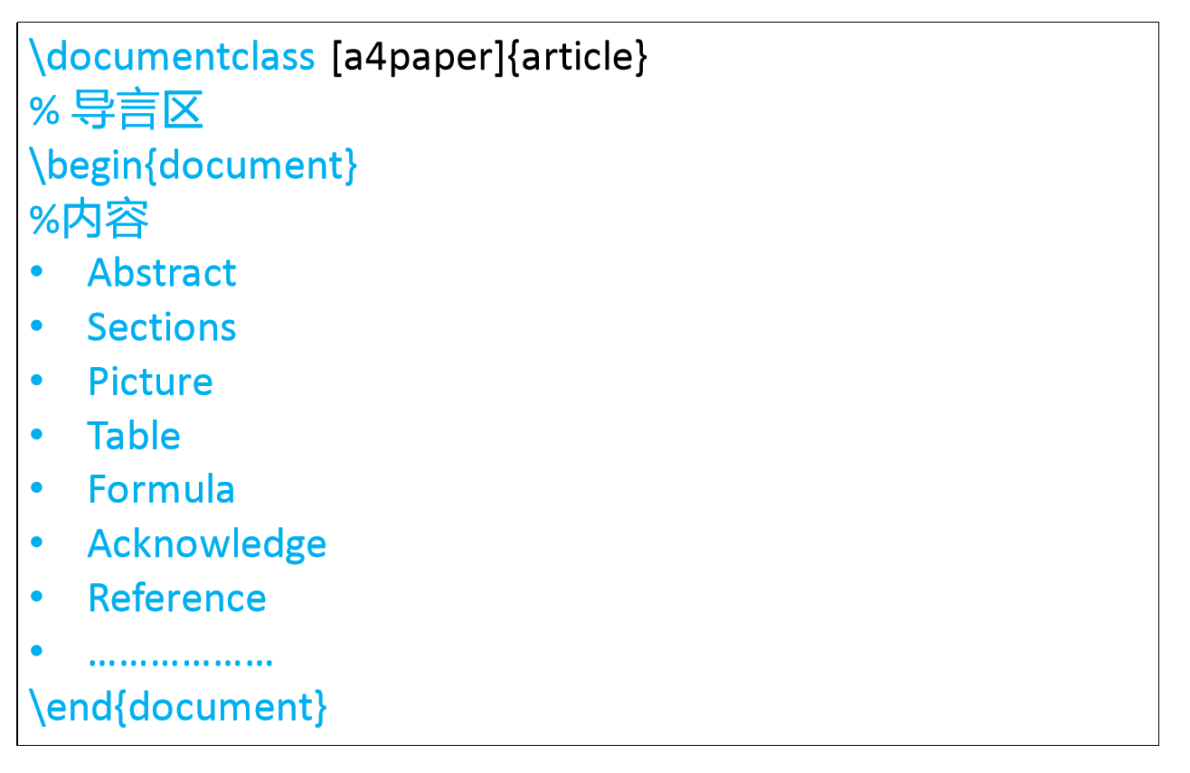

Slide 29
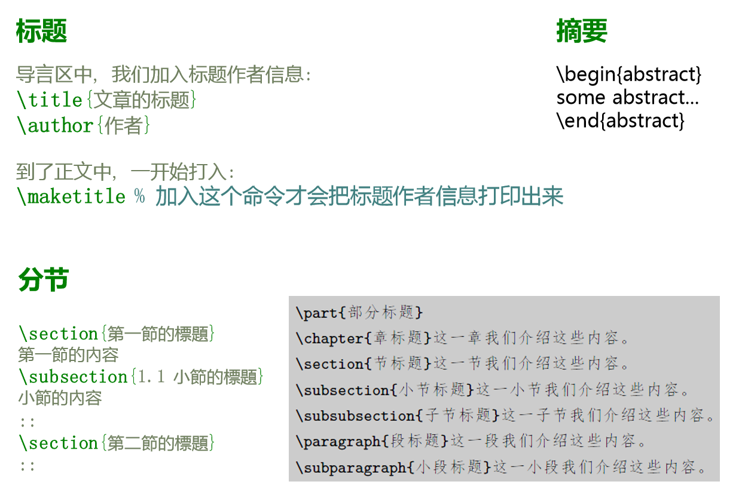

Slide 30
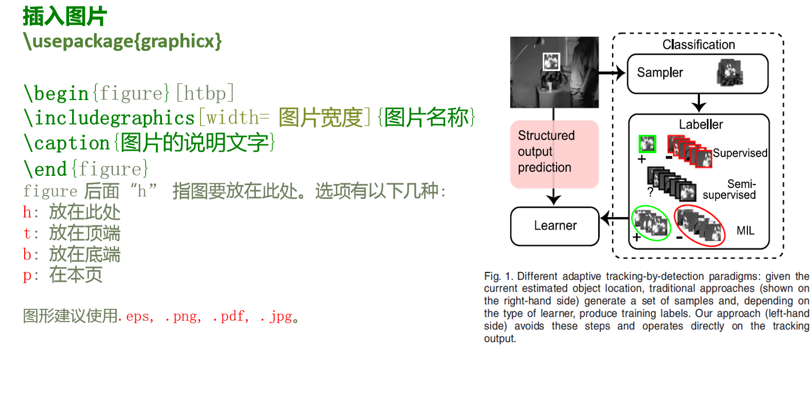

Slide 31
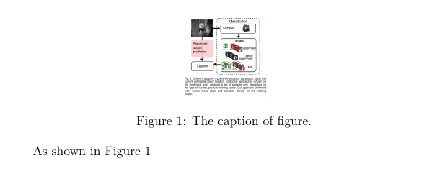
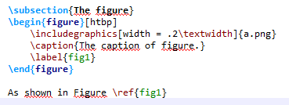

Slide 32
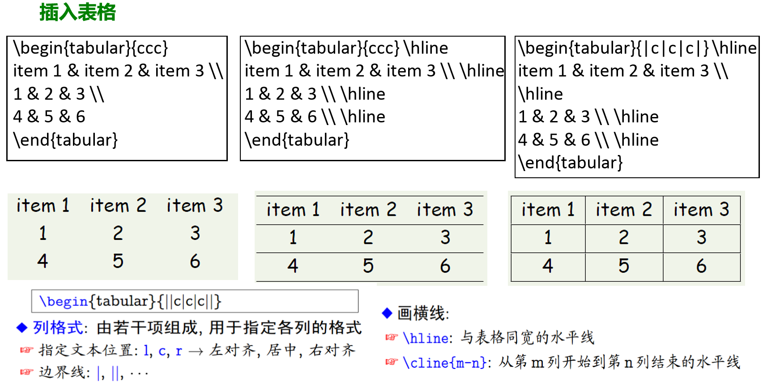

Slide 33
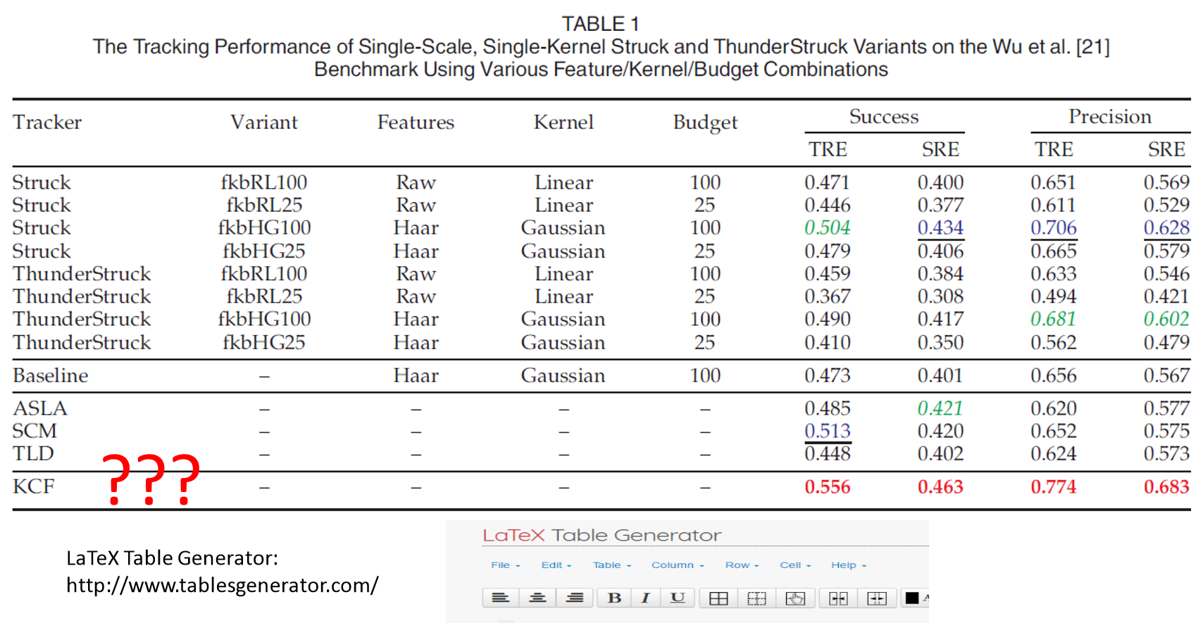

Slide 34
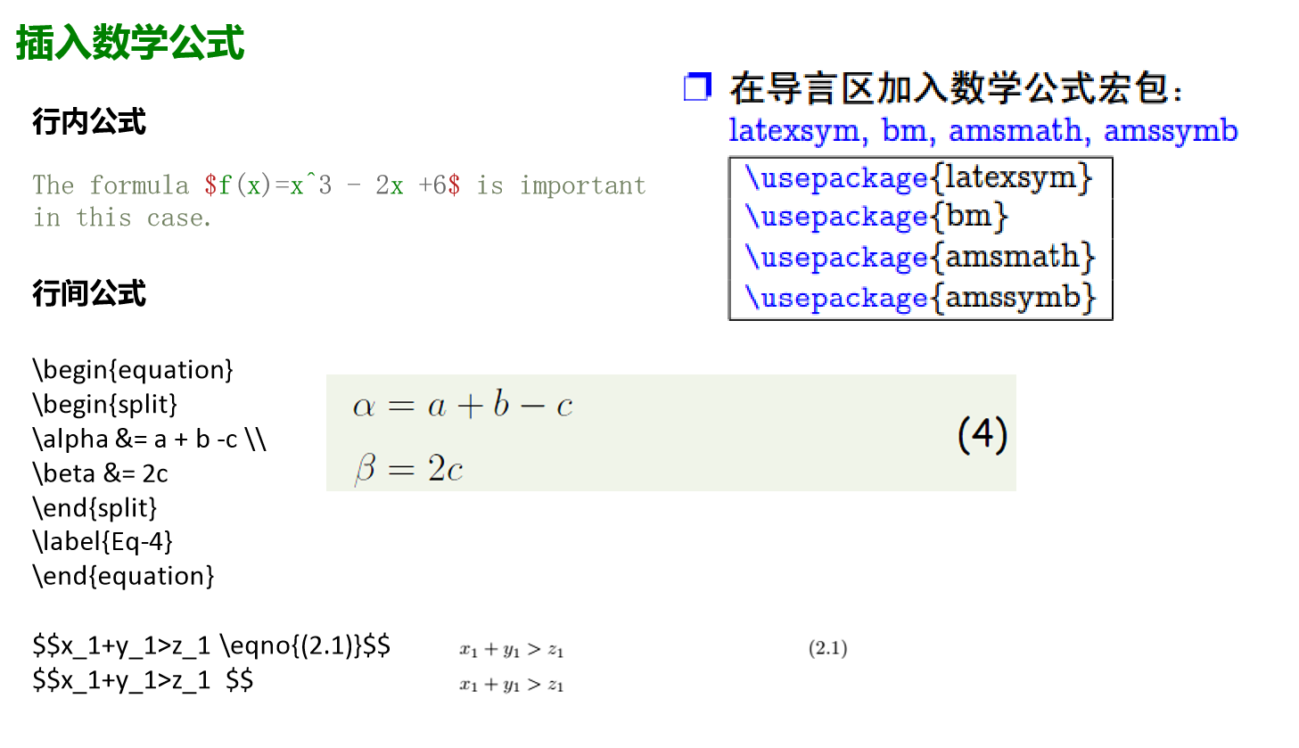

Slide 35
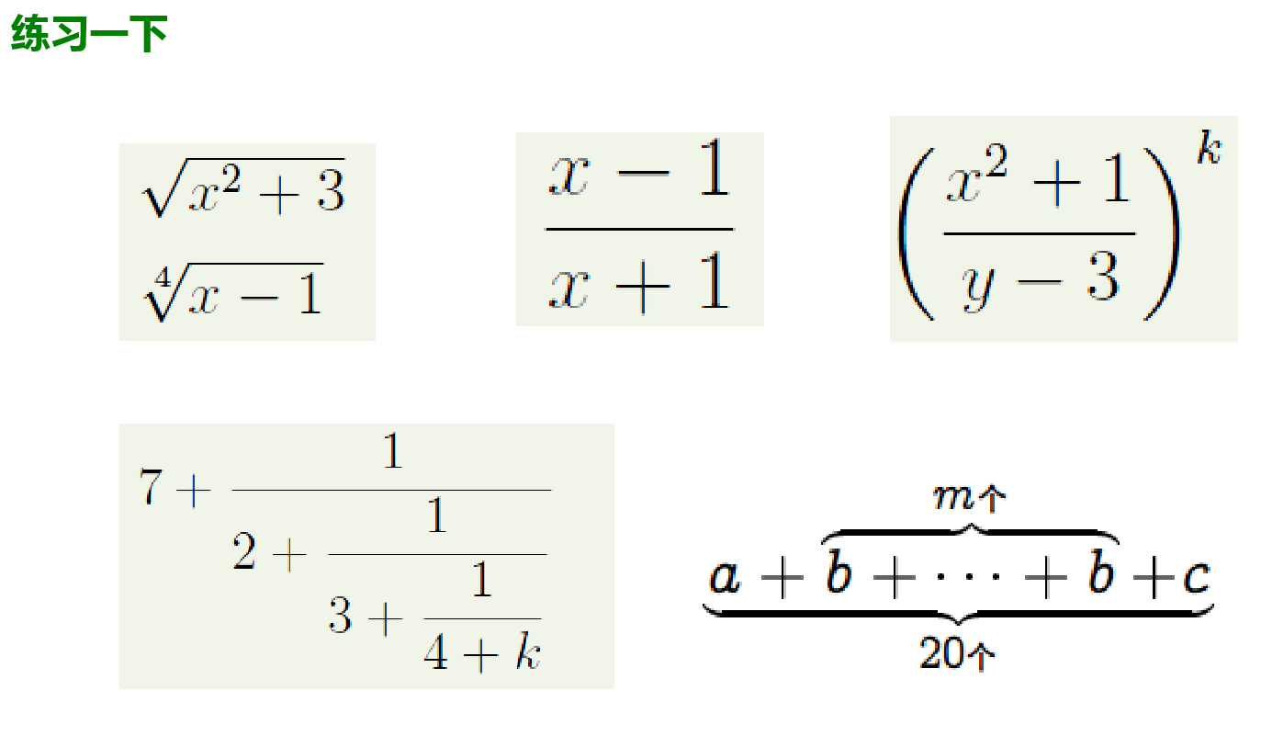

Slide 36
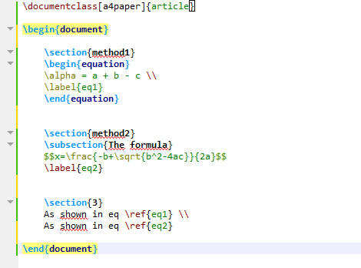
方法1
方法2

Slide 37
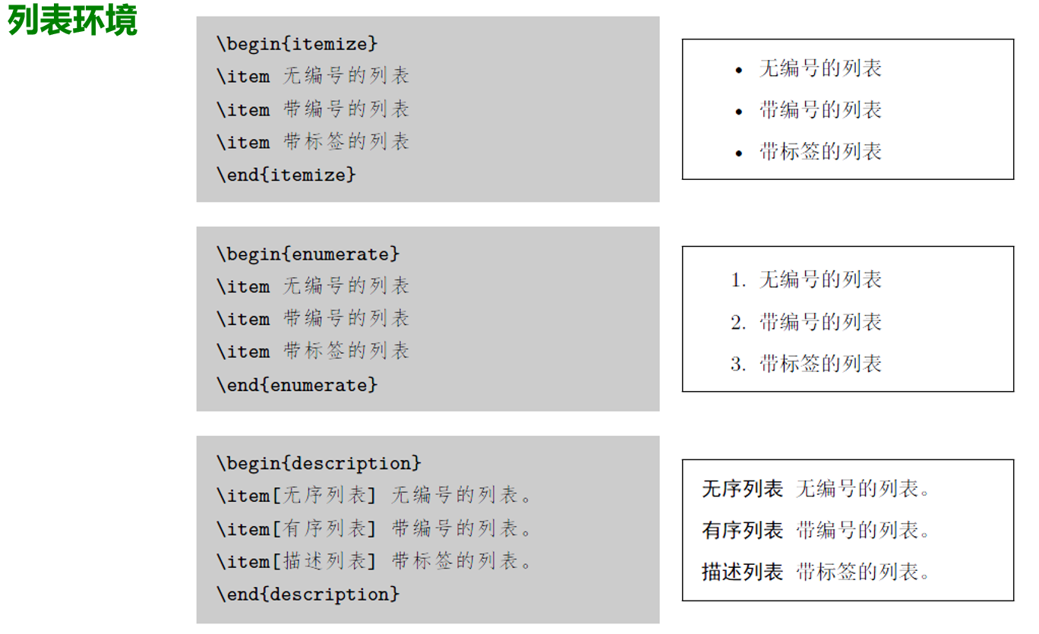

Slide 38
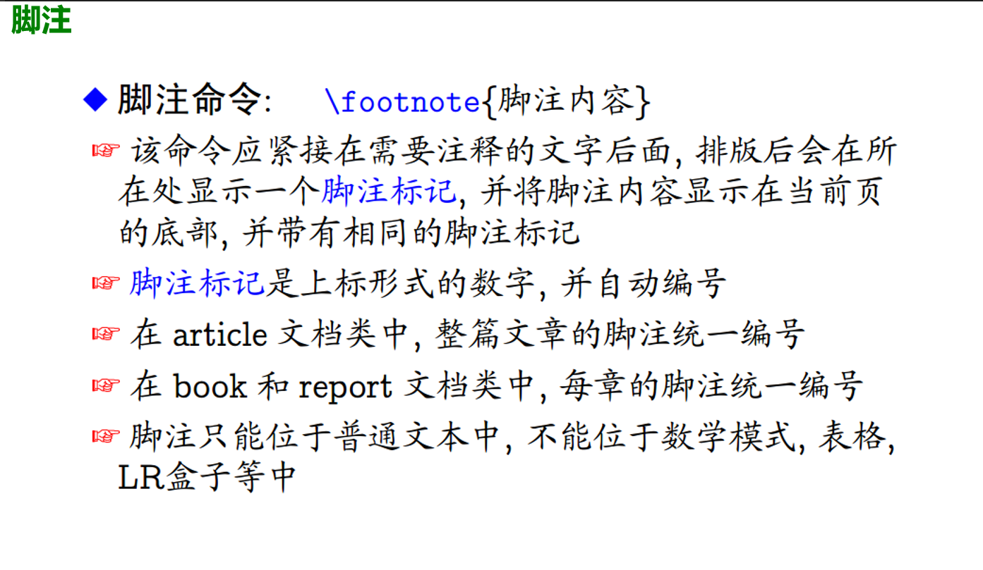

Slide 39
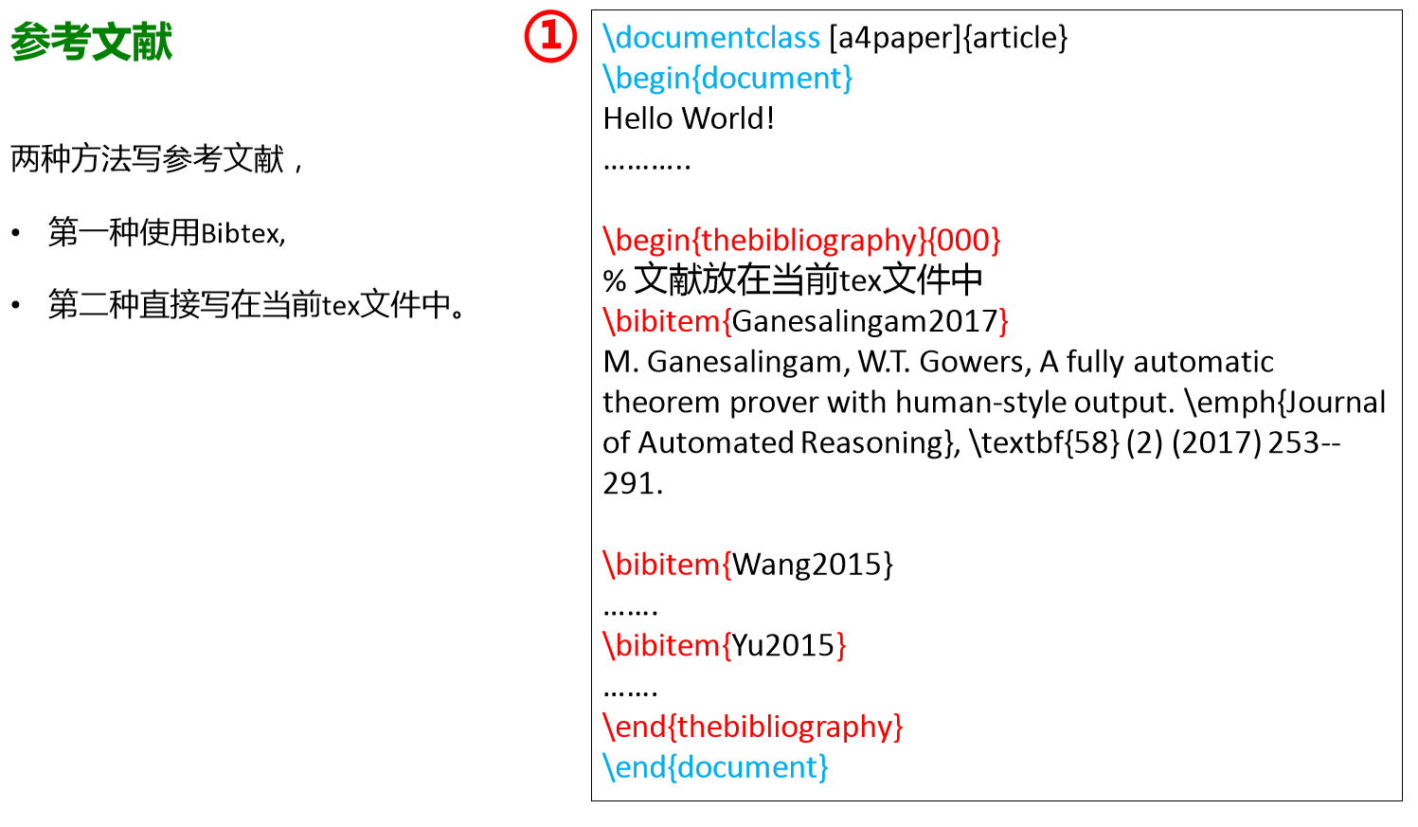

Slide 40
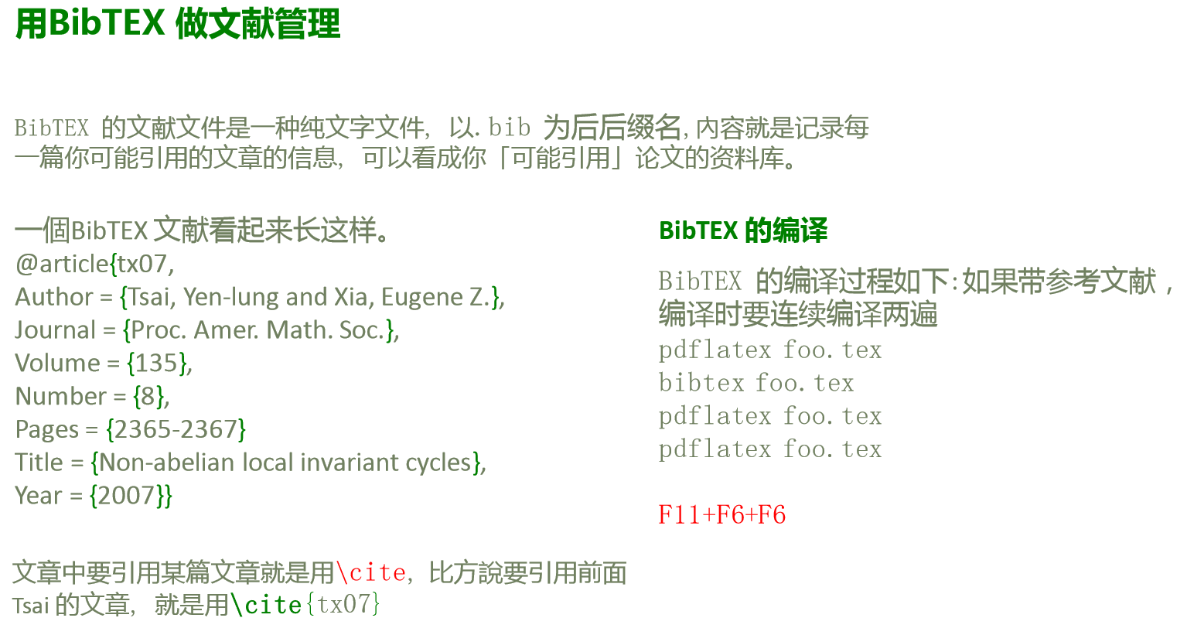

Slide 41
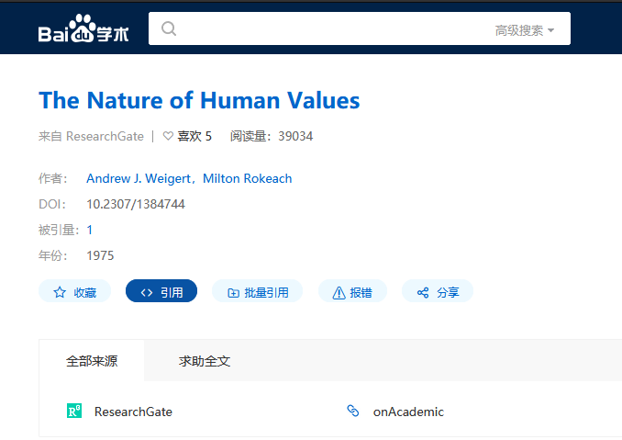
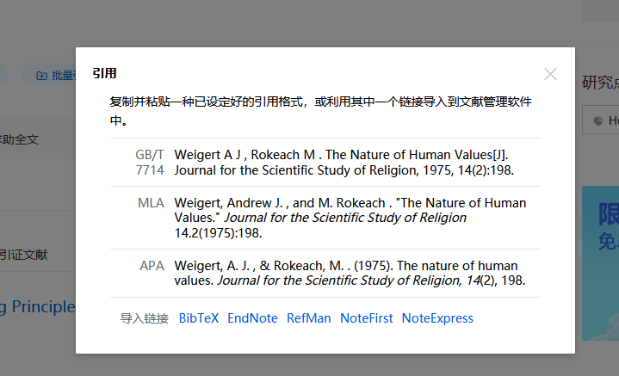
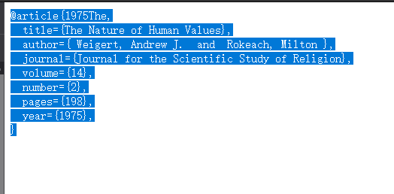

Slide 42
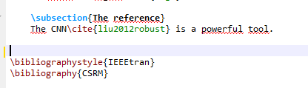
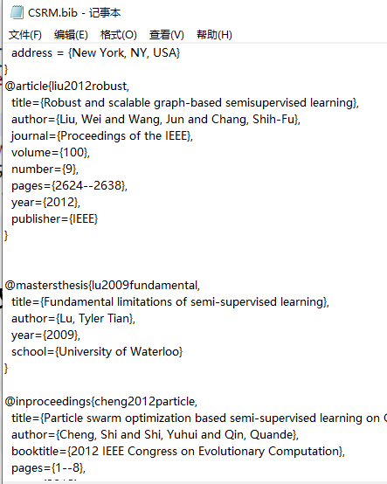

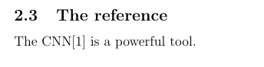
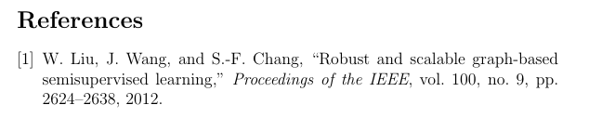
文献索引码
引用格式
BIB文件名

Slide 43
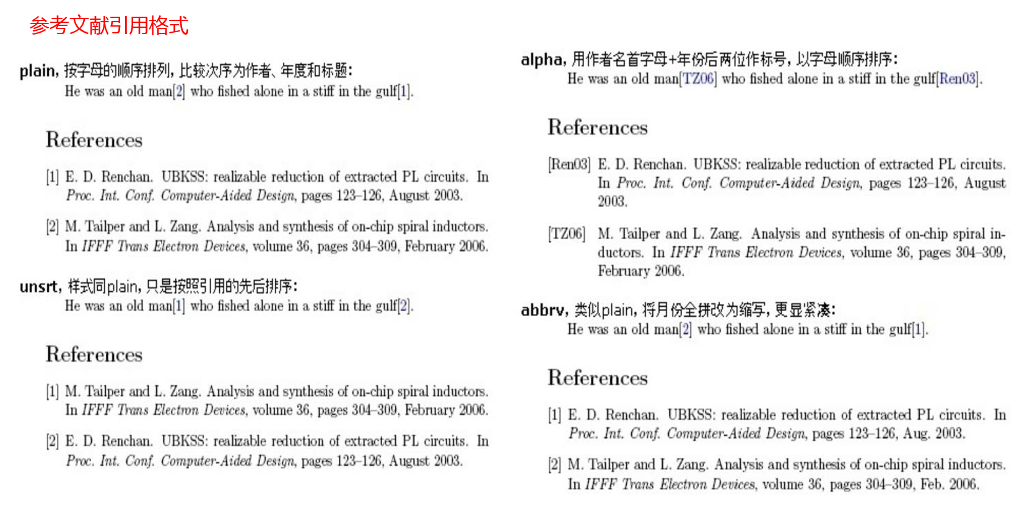

Slide 44
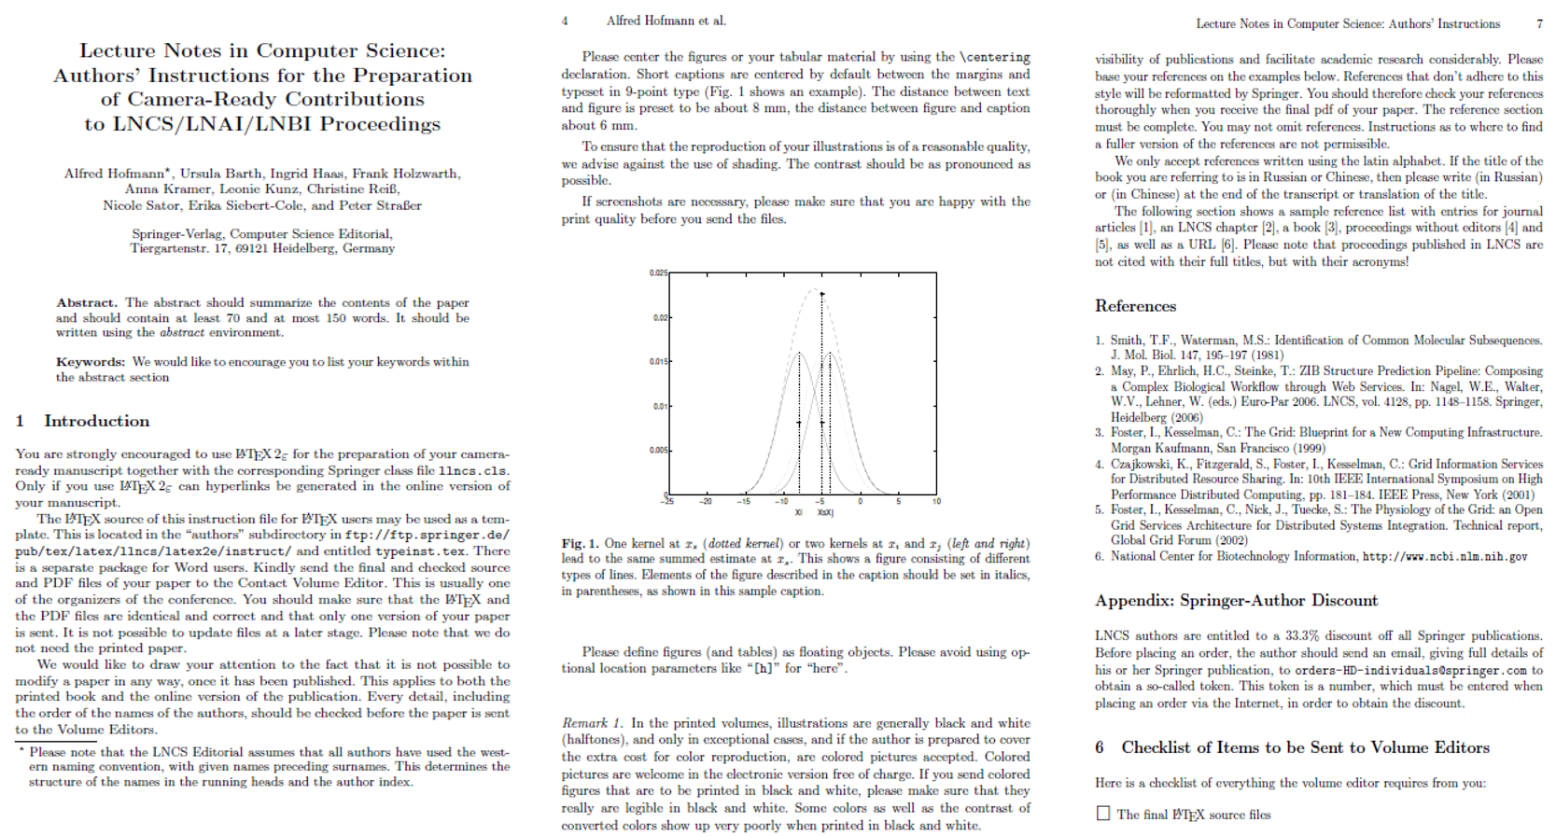

Slide 45
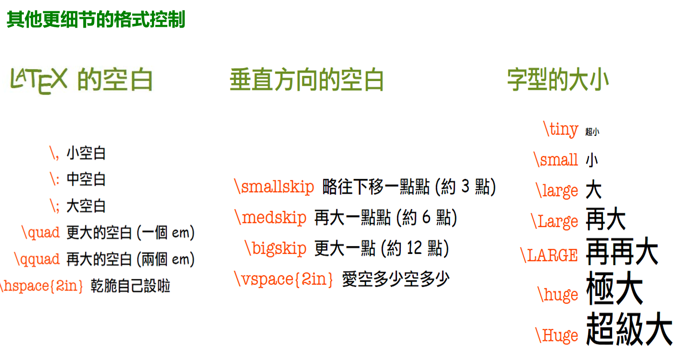

Slide 46
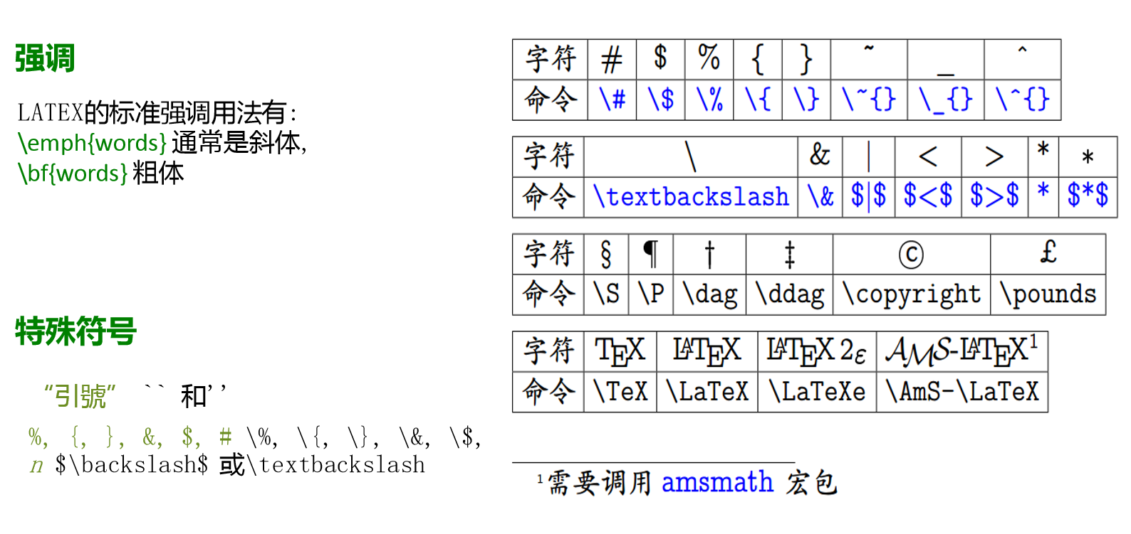

Slide 47
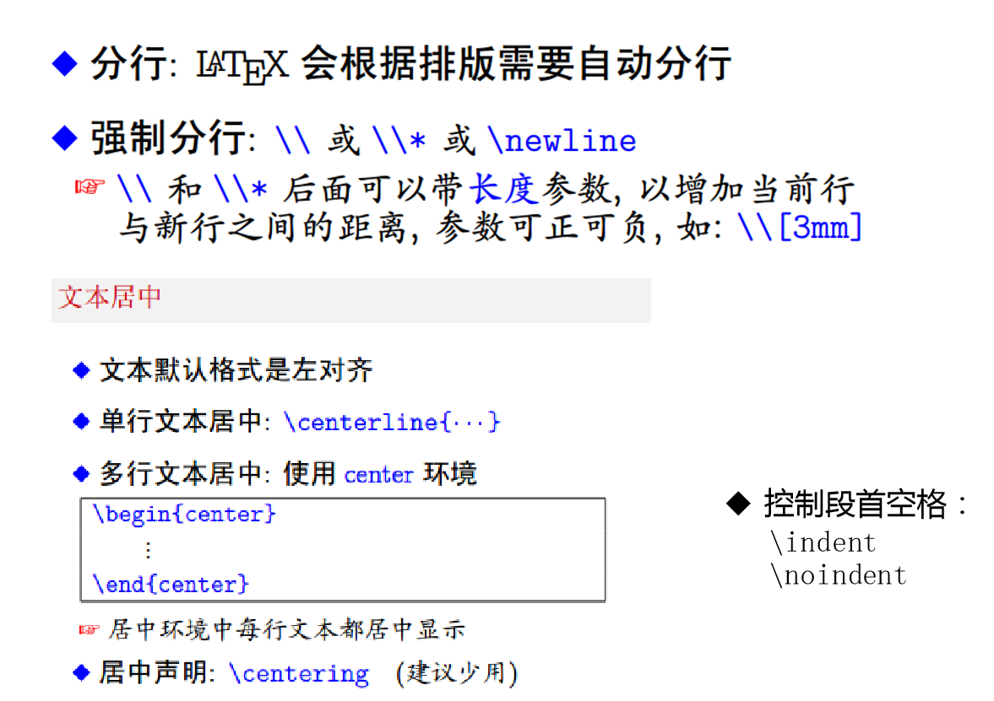

Slide 48
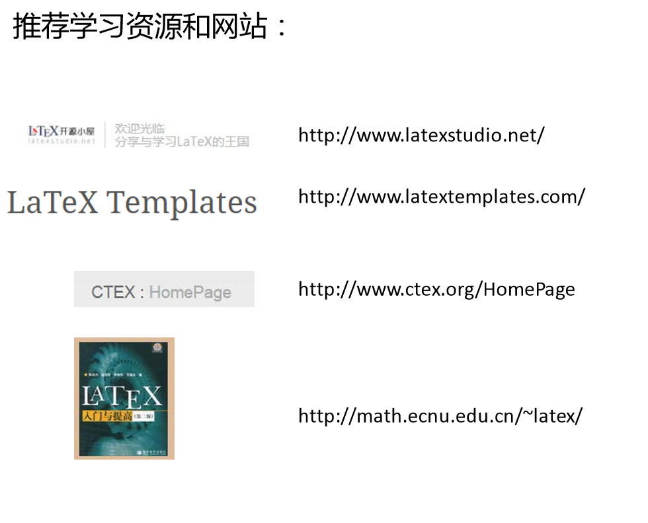

Slide 49
Any questions can be put to us by e-mail ,
Before you receive your grade in Moodle.
THANKS

